Slide 1

S.M.A.R.T. Downloader
Secure, Multi-browser Complaint, Agile, Resilient, Threaded-Control
Manjunath T : 1PI02CS056
Niranjan N : 1PI02CS062
Pavan Kumar K : 1PI02CS068
Guide
Mr.Suresh Jamadagni
(Batch:CS85/2006/022)
Dept of Computer Science Feb-June ’06

Slide 2
Overview Of The Presentation
S.M.A.R.T Downloader
Motivation
SMART Downloader :An Introduction
Goals and Guidelines
Features
Modules of the project
Implementation
Future enhancements
Dept of Computer Science Feb-June ’06

Slide 3
Motivation
S.M.A.R.T Downloader
None of the existing applications have the characteristics which can appeal to a universal audience.
They lack in one aspect or the other in terms of performance ,features, UI aspects etc.
Most of them also lack platform independence.
Dept of Computer Science Feb-June ’06

Slide 4
Existing Applications
S.M.A.R.T Downloader
Sl .No | Name | Where they lack
1 | GwGet | No zip and media preview, No Anti Virus Scanner
2 | Internet Download manager | No support for Encryption
3 | Download Studio | No scheduling
4 | Go!Zilla | Congested UI, No Anti Virus
Dept of Computer Science Feb-June ’06

Slide 5
SMART Downloader :An Introduction
S.M.A.R.T Downloader
The basic function of the downloader is to download files from the internet meanwhile providing a lot of flexibility to the users during the file download.
But S.M.A.R.T Downloader is much more than just a download manager.
Dept of Computer Science Feb-June ’06

Slide 6
Our Acronym : S.M.A.R.T
S.M.A.R.T Downloader
Secure
Multi-browser compliant
Agile
Resilient
Threaded Control
Dept of Computer Science Feb-June ’06

Slide 7
Goals and guidelines
S.M.A.R.T Downloader
Emphasis on Speed to facilitate faster download-times.
Visually appealing and easy-to-use interface with comprehensive error recovery.
Provide least surprise to users
Provide features that target both power users and novice users with sensible distinction between the two classes of users.
Seamlessly integrate with popular browsers.
Dept of Computer Science Feb-June ’06

Slide 8
Features
S.M.A.R.T Downloader
Scheduler to schedule download to occur at a pre specified time
Pausing and resuming of download at any point during download
File versioning – Alerts the user on an attempt to download an already downloaded file.
Can be used as stand-alone or as a add-on to the browser
Pipeline jobs for ‘fine-grained’ control over downloading
Multi-threaded
Uploading services
Dept of Computer Science Feb-June ’06

Slide 9
Distinguishing features…. ☺☺☺
S.M.A.R.T Downloader
File encryption/decryption support for better security
FTP : Support FTP download and upload
Media Preview - A quick preview of a media file before downloading completely. It is distinct in that it supports all media formats.
Redirection - Download to a specified location on the network
Zip Preview – preview files in archives and selectively download files
Built-in XML validator – Validate an XML file against its schema definition provided so that users can ignore invalid XML files
Dept of Computer Science Feb-June ’06

Slide 10
Implementation
S.M.A.R.T Downloader
Each module is implemented as a
separate project.
The main module references the libraries
created by the other modules .
Each of the modules can be reused individually or as libraries.
Dept of Computer Science Feb-June ’06

Slide 11
Basic Downloader
S.M.A.R.T Downloader
The module uses HTTP request and response for downloading.
Controlled Downloader is a wrapper class over the basic downloader and implements pause, resume and stop functionalities.
For every file downloaded, statistics are written to a file.
Dept of Computer Science Feb-June ’06

Slide 12
Scheduler
S.M.A.R.T Downloader
It allows the users to schedule the download at the future point of time .
How it Works
Calculate the difference between current date time and scheduled date time in terms of number of seconds and setting a Timer callback for it .
Dept of Computer Science Feb-June ’06

Slide 13
Support for FTP
S.M.A.R.T Downloader
Allowing the user to browse through local file system , and selectively upload folder or files to remote site .
It allows user to connect to remote ftp server using basic authentication scheme .
Once user is connected to remote server , he can access remote file system as local file system . He can create new files or folders on remote system .
Dept of Computer Science Feb-June ’06

Slide 14
Automatic virus scan
S.M.A.R.T Downloader
We use the command line virus scanner provided by Trend Micro. It uses the latest virus patterns available while scanning for the virus .
Scanning the downloaded file for virus is an option . The user can bypass virus scanning.
The Virus scanner tries to clean or quarantine the downloaded file if it is possible . If not, the scanner does not allow users to save the file .
Dept of Computer Science Feb-June ’06

Slide 15
Integration with the existing browsers
S.M.A.R.T Downloader
At present we use Flashgot, an extension to Mozilla platform to integrate with the Firefox browser.
Flashgot extension allows us to integrate with other browsers like Opera , Mozilla , Netscape , etc.
To integrate with IE 6 and above, we need to leverage the COM interface IDownload which inherits from IUnknown .
Dept of Computer Science Feb-June ’06

Slide 16
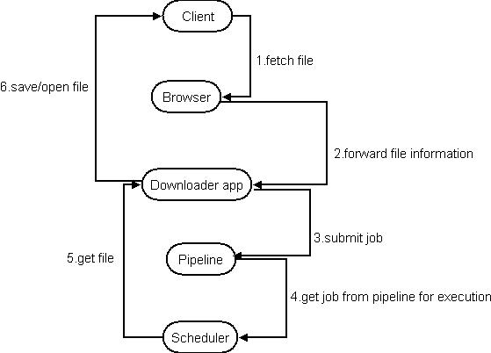
Collaboration Diagram
S.M.A.R.T Downloader
Dept of Computer Science Feb-June ’06

Slide 17
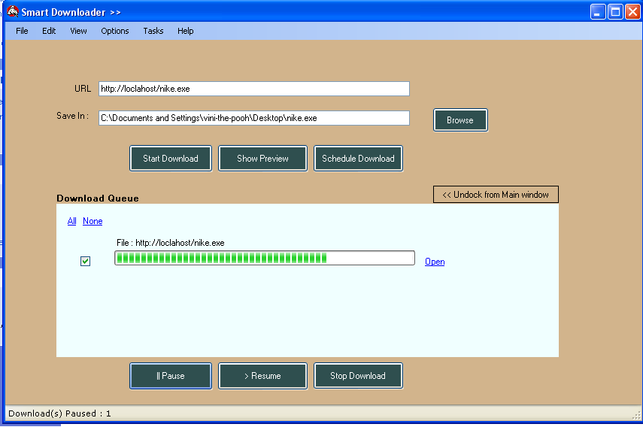
User Interface
S.M.A.R.T Downloader
Dept of Computer Science Feb-June ’06

Slide 18
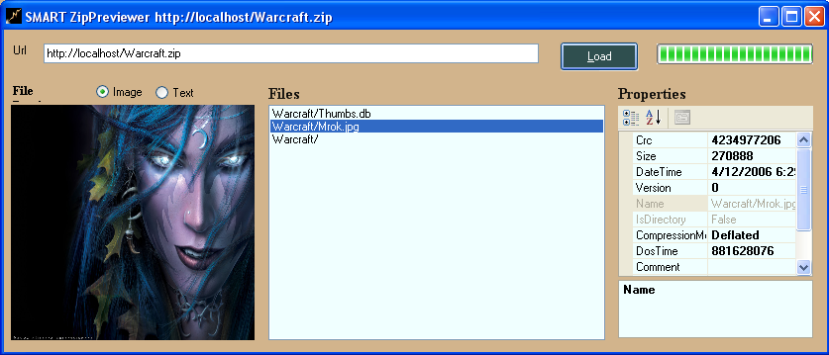
UI of Zip Preview

Slide 19
Future Enhancements
S.M.A.R.T Downloader
Support for bit torrents
Downloading several files from a site automatically according to simple rules (file types, updated files, pattern template etc.).
Web services support
  Facilitate XML web services discovery and consumption.
  Support UDDI, WSDL, SOAP, etc.
Dept of Computer Science Feb-June ’06

Slide 20
S.M.A.R.T Downloader
Thank you !!!☺
Dept of Computer Science Feb-June ’06

